Slide 1
Digital transmission

Slide 2
Contents
Digital Data to Digital Signal Conversion
Analog Data to Digital Signal Conversion
Transmission Modes (Serial and Parallel Transmission)

Slide 3
Digital Transmission
Information needs to be converted into either a digital signal or an analog signal
Focus on schemes and techniques for digital transmission i.e. where signal elements are digital
Digital to Digital Conversion: Converting Digital Data into Digital Signals
Analog to Digital Conversion: Changing Analog signal into digital signal
Transmission Modes: Deciding Serial or Parallel Transmission of data

Slide 4
Digital-to-Digital Conversion
Line Coding
Line Coding Schemes
Block Coding
Scrambling

Slide 5
Line Coding
A simple coding of binary signal is high voltage level for bit ‘1’ and low voltage level for bit ‘0’
Several bit patterns like long sequence of 1s or 0s lead to generation of signal which is difficult for receiver to interpret.
Apart from this the receiver suffers from several other issues like Baseline-wandering, DC Component, and synchronization due to such data patterns
Line coding techniques are sophisticated methods to generate signal element which produces patterns which deals with above mentioned problems.

Slide 6
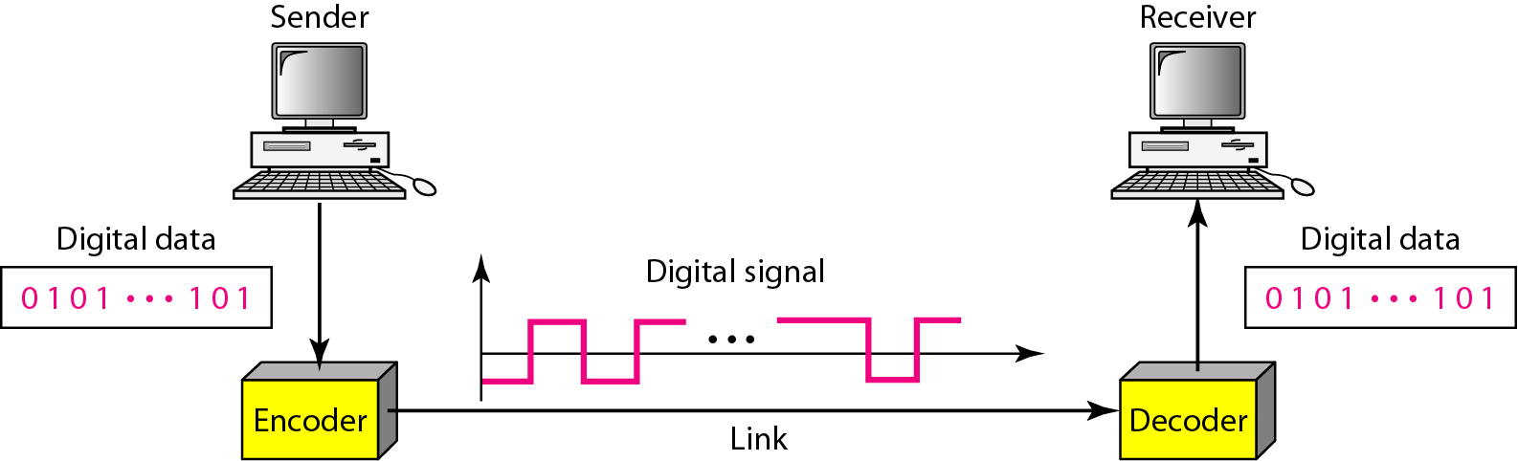
Line Coding
Process of converting digital data (in bits) to digital signals is called the Line Coding
Line Coding and Decoding

Slide 7
Line Coding: Common Characteristics
Signal Element Versus Data Element
  Data element is the smallest entity that can represent a piece of information (this is the bit)
  Signal element carries data elements and is the shortest unit of a digital signal
  Data elements are what we want to send; Signal elements are what we can send
  Data elements are being carried
  Signal elements are the carriers
Define ratio r as the number of data elements carried by one signal element

Slide 8
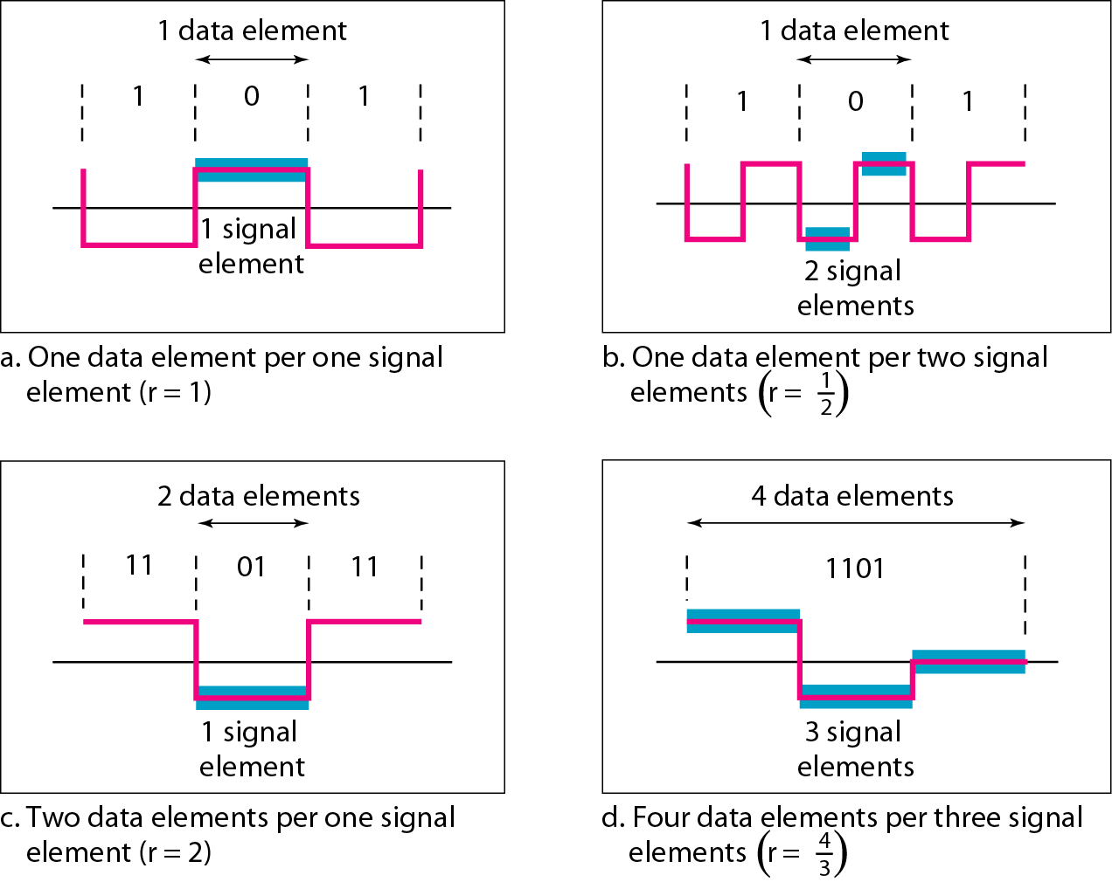
Signal Element Vs. Data Element

Slide 9
Line Coding: Common Characteristics
Data Rate Versus Signal Rate
  Data rate defines number of data elements (bits) sent in 1 second (bps)
  Signal rate is the number of signal elements sent in 1 second (baud)
  Data rate is also called bit rate
  Signal rate is called a pulse rate or modulation rate or the baud rate
Goal of the data communications is to increase data rate while decreasing signal rate
Increasing data rate increases speed of transmission
Decreasing signal rate decreases the bandwidth requirement

Slide 10
Given S is the Signal Rate, N is the Data Rate (bps)
S = N / r
This relationship also depends on data patterns. For a data pattern of all 0s or all 1s, the signal rate will be different compared to alternating 0s and 1s.
To properly model this relationship, 3 cases are considered:
  Best case - we need minimum signal rate
  Worst case – we need maximum signal rate
  Average case – we are interested in
  c is case factor, which varies for the best, average and worst cases
  S_{ave} = c * N * (1/r) baud

Slide 11
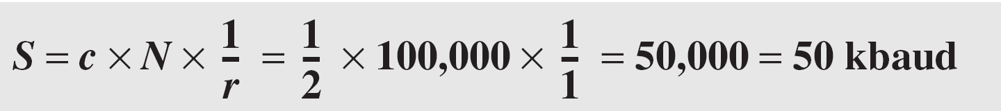
A signal is carrying data in which one data element is encoded as one signal element ( r = 1). If the bit rate is 100 kbps, what is the average value of the baud rate if c is between 0 and 1?
Solution
We assume that the average value of c is 1/2 . The baud rate is then

Slide 12
Line Coding: Common Characteristics
Bandwidth
  Digital signal is nonperiodic
  Bandwidth of nonperiodic digital signal is continuous and theoretically infinite
  Effective bandwidth is finite
  Baud rate and not the bit rate determines the required bandwidth for a digital signal
  More changes in signal means injecting more frequencies into signal
  Range of bandwidth and Amplitude are also important, rather than its value
Although the actual bandwidth of a digital signal is infinite, the effective bandwidth is finite.

Slide 13
Minimum Bandwidth can be given as –
B_{min} = c * N * (1/r)
Maximum data rate is
N_{max} = (1/c) * B * r

Slide 14
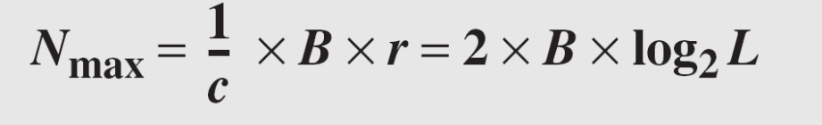
The maximum data rate of a channel (see Chapter 3) is Nmax = 2 × B × log₂ L (defined by the Nyquist formula). Does this agree with the previous formula for N_{max}?
Solution
A signal with L levels actually can carry log₂L bits per level. If each level corresponds to one signal element and we assume the average case (c = 1/2), then we have

Slide 15
Line Coding: Common Characteristics
Baseline Wandering
  Receiver calculates a running average of the received signal power
  This average is called Baseline
  Incoming signal is evaluated against this baseline to determine the value of the data element
  A long string of 0s or 1s can cause a drift in the baseline (baseline wandering)
    Receiver cannot decode the information correctly
  Design a line coding scheme that prevent baseline wandering

Slide 16
Line Coding: Common Characteristics
DC Components
  When the voltage level in a digital signal is constant for a while, the spectrum creates very low frequencies
  These frequencies (around zero) are called DC (direct-current) components
    Present problems for a system that cannot pass low frequencies
    DC component is 0/1 parity that can cause base-band wandering
    When a signal contains an equal number of 0s and 1s over time, it has no DC component (balanced).
    If there are more 0s than 1s (or vice versa), the signal develops a DC offset.

Slide 17
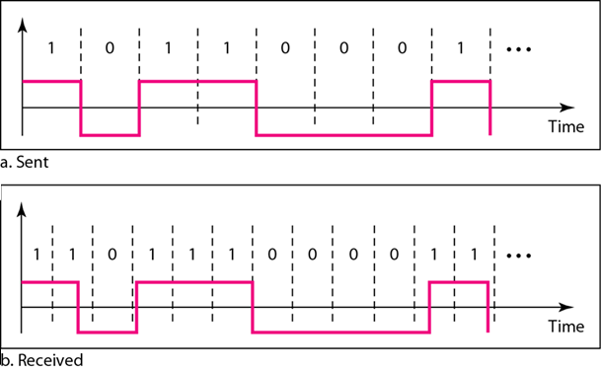
Line Coding: Common Characteristics
Self-synchronization
  Receiver’s bit intervals must correspond exactly to the sender’s bit intervals to interpret the signals correctly
  If the receiver clock is faster or slower, the bit intervals are not matched and the receiver might misinterpret the signals.
Effect of Lack of Synchronization

Slide 18
Line Coding: Common Characteristics
Self-synchronization
  A self-synchronizing digital signal includes timing information in the data being transmitted.
  This can be achieved if there are transitions in the signal that alert the receiver to the beginning, middle, or end of the pulse.
  If the receiver’s clock is out of synchronization, these points can reset the clock

Slide 19
In a digital transmission, the receiver clock is 0.1 percent faster than the sender clock. How many extra bits per second does the receiver receive if the data rate is 1 kbps? How many if the data rate is 1 Mbps?
Solution
At 1 kbps, the receiver receives 1001 bps instead of 1000 bps.
At 1 Mbps, the receiver receives 1,001,000 bps instead of 1,000,000 bps.

Slide 20
Line Coding: Common Characteristics
Built-in Error Detection
  Used to detect some or all of the errors that occurred during transmission
Immunity to Noise and Interference
  Code should be immune to noise and other interferences
Complexity
  A complex scheme is more costly to implement than a simple one
    A signal that uses four signal levels is more difficult to interpret than one that uses only two levels

Slide 21
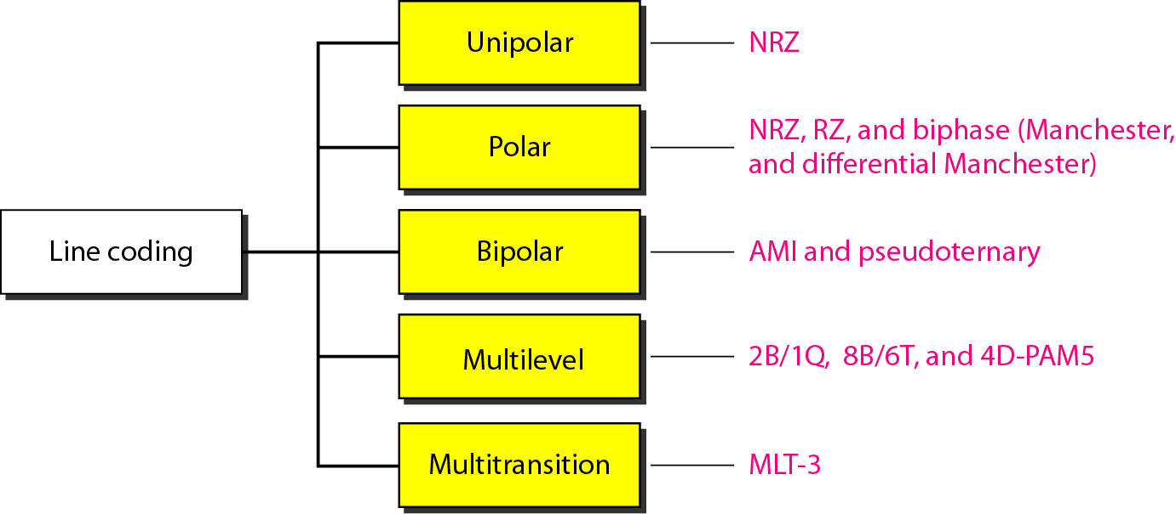
Line Coding Schemes
5 Categories

Slide 22
Line Coding Schemes: Unipolar
All signal levels are on one side of the time axis, either above or below
Designed as a Non-Return-to-Zero (NRZ) scheme
  Positive voltage defines bit 1 and the zero voltage defines bit 0
NRZ – signal does not return to zero at the middle of the bit
Scheme is costly
  The normalized power (power needed to send 1 bit per unit line resistance) is double
  Hence not used in communications these days

Slide 23
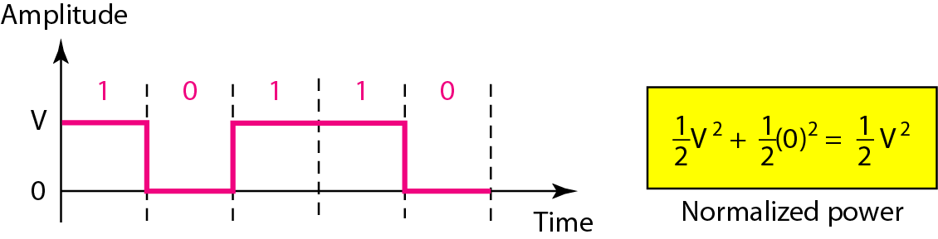
Unipolar NRZ Scheme
Scheme is prone to baseline wandering and DC components.
It has no synchronization or any error detection.
It is simple but costly in power consumption.

Slide 24

Normalized Power
  In physics, Power (P) is calculated as , where V is voltage and R is resistance.
  To simplify the analysis of line codes, we assume the load resistance is normalized to 1 . So the power is just P=V²
  The Normalized Power determines the "cost" of sending the signal.
  Since digital signals change values over time (e.g., shifting between +V and 0V), normalized power is usually expressed as the average power over a bit duration.
  If a signal uses different voltage levels with equal probability, the average normalized power
  In unipolar NRZ, Half the time the signal is +V (Power = V²). Half the time the signal is 0 (Power = 0). Average Normalized Power: .
  Polar NRZ-L (+V and -V): Half the time the signal is +V (Power = V²). Half the time the signal is -V (Power = (-V)² = V²). Average Normalized Power: V²

Slide 25
Power Spectral Density (PSD)
  PSD describes how the power of a signal is distributed across different frequencies. It is the critical tool for determining the bandwidth required to transmit a signal and for checking if a signal has a DC component

Slide 26
Line Coding: Polar
Voltages are on both sides of the time axis
Voltage level for 0 can be positive and the voltage level for 1 can be negative
Non-Return-to-Zero
  2 Versions
    Non-Return-to-Zero Level (NRZ-L) – Positive Voltage for one symbol and negative for the other
    Non-Return-to-Zero Invert (NRZ-I) – the change or lack of change in polarity determines value of symbol
  Baseline wandering is common problem
    Twice as severe in NRZ-L
  Sender/receiver clock synchronization issues
    More serious in NRZ-L
NRZ-L and NRZ-I both have an average signal rate of N/2 Bd.

Slide 27
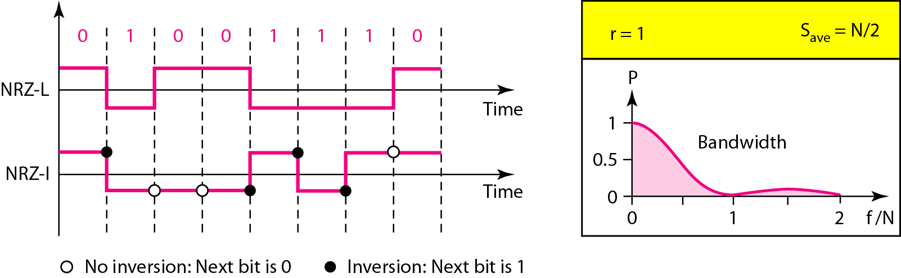
Polar NRZ-L and NRZ-I schemes
Power Spectral Density (PSD) & Bandwidth
  The x-axis represents frequency normalized by the bit rate N.
  The majority of the power is concentrated at low frequencies, meaning Polar NRZ requires less bandwidth than RZ.
  The low-frequency component is strong, meaning DC components are present
In NRZ-L the level of the voltage determines the value of the bit.
In NRZ-I the inversion or the lack of inversion determines the value of the bit.

Slide 28
A system is using NRZ-I to transfer 1-Mbps data. What are the average signal rate and minimum bandwidth?
Solution
The average signal rate is S= c x N x R = 1/2 x N x 1 = 500 kbaud.
The minimum bandwidth for this average baud rate is B_{min} = S = 500 kHz.
Note c = 1/2 for the avg. case as worst case is 1 and best case is 0

Slide 29
Line Coding: Polar
Return to Zero
  Uses 3 values – Positive, Negative and Zero
  Signal changes not between the bits but during the bit
  Requires two signal changes to encode a bit and therefore occupies greater bandwidth
  No DC component
  More complex to create as 3 levels
  Hence not used these days
  Replaced by Manchester and Differential Manchester schemes

Slide 30
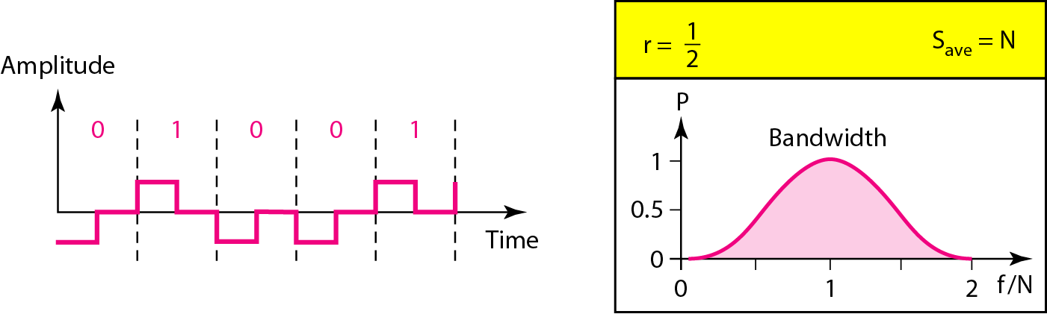
Polar RZ Scheme
Power Spectral Density (PSD) & Bandwidth
  The signal energy is distributed mostly in the low-frequency range, but it spreads more than NRZ due to the frequent transitions (returning to zero)
  The bandwidth requirement is higher than NRZ because of the additional transitions

Slide 31
Line Coding: Polar
Biphase
  Manchester and Differential Manchester
  Manchester Encoding has idea of NRZ-L and RZ
  Differential Manchester Encoding combines idea of NRZ-I and RZ
  No baseline wandering
  No DC component
  Signal rate is double than that for NRZ
    There is always one transition at the middle of the bit and may be one transition at the end of each bit

Slide 32
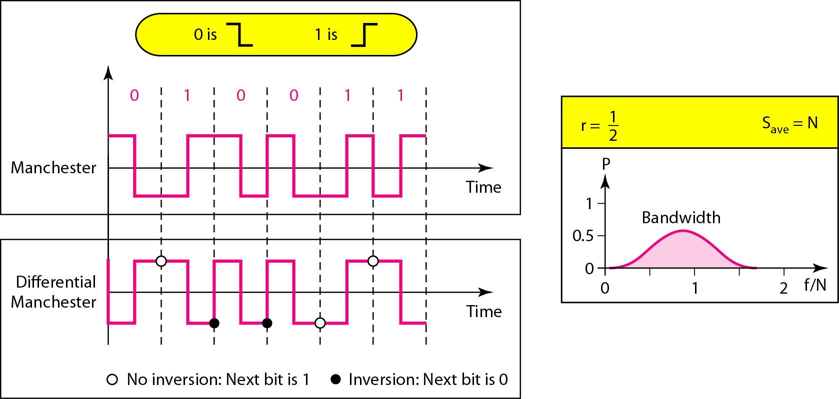
Polar Biphase: Manchester and Differential Manchester Schemes
In Manchester and differential Manchester encoding, the transition
at the middle of the bit is used for synchronization.

Slide 33
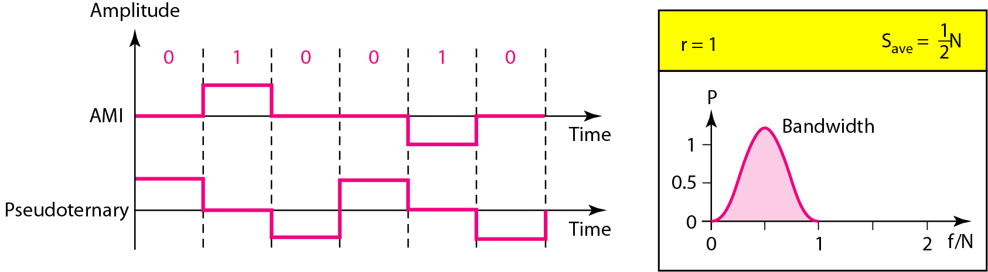
Line Coding: Bipolar
AMI (Alternative Mark Inversion) and Pseudoternary
Also called multilevel binary
3 voltage levels – Positive, Negative, Zero
  Voltage level for one data element is at zero, voltage level for other element alternates between positive and negative

Slide 34
Line Coding: Bipolar
Same signal rate as NRZ
No DC component
Concentration of energy is found around frequency N/2
AMI is commonly used for long –distance communication
  Has synchronization problem when a long sequence of 0s is present in the data

Slide 35
Line Coding: Multilevel Schemes
Goal is to increase the number of bits per baud by encoding a pattern of m data elements into a pattern of n signal elements
  Group m data elements to produce a combination of 2^{m} data patterns
  If there are L levels, L^{n} combinations of signal patterns can be produced
  If 2^{m} = L^{n}, each data pattern is encoded using one signal pattern utilizing all signal patterns
  If 2^{m} < L^{n}, data patterns occupy only a subset of signal patterns
  This subset can be carefully designed to prevent baseline wandering, provide synchronization and to detect errors that occurred during transmission
  Data encoding is not possible if If 2^{m} > L^{n}, because some data patterns cannot be encoded

Slide 36
Line Coding: Multilevel Schemes
Codes are classified as mBnL
  m is length of binary pattern
  B means binary data
  n is length of signal pattern
  L is number of levels in the signalling
2B1Q – two binary, one quaternary
8B6T – eight binary, six ternary
4D – PAM5 – four-dimensional five level pulse amplitude modulation

Slide 37
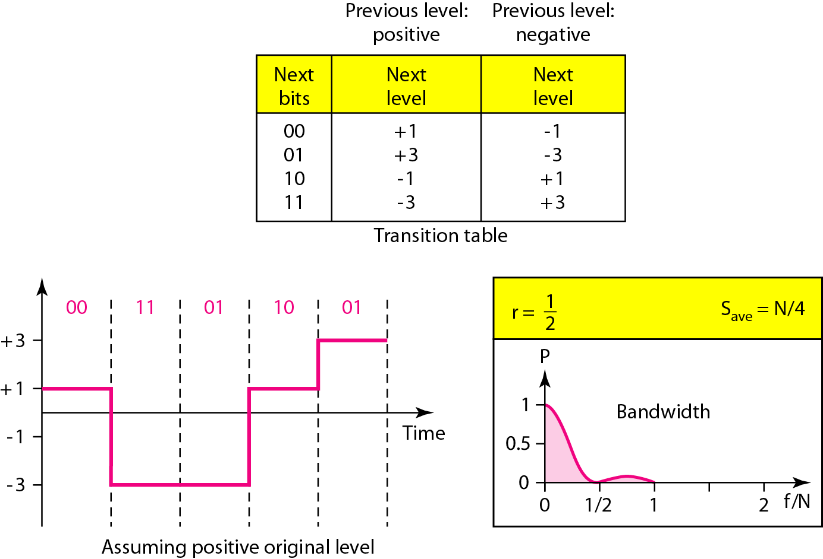
2B1Q
Multilevel: 2B1Q – used in Digital Subscriber Line (DSL)
In the 2B1Q scheme, we have no redundancy and we see that there is a possibility of DC component

Slide 38
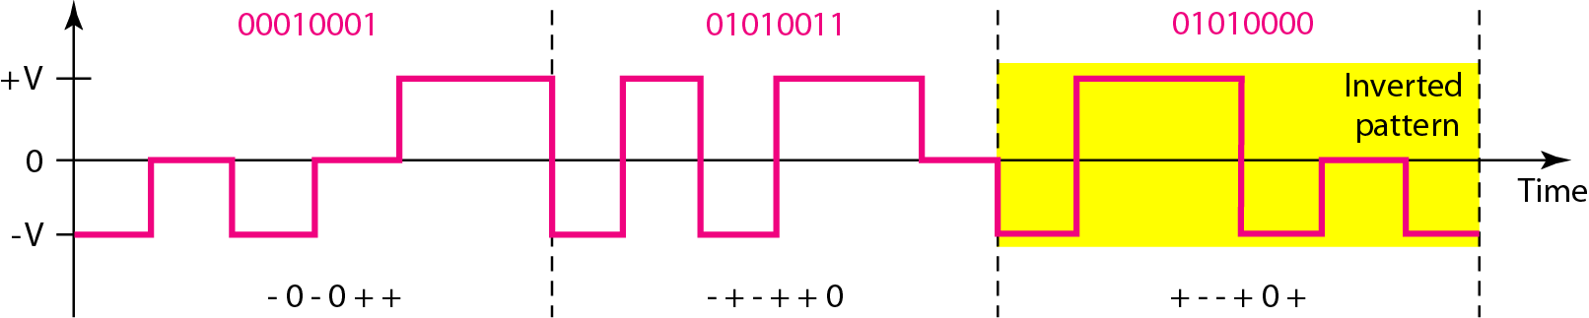
8B6T
Multilevel: 8B6T – used with 100BASE-4T Cable
encode a pattern of 8 bits as a pattern of six signal elements, where the signal has three levels (ternary)
No. of data patterns = 2^8 = 256
L = 3
Signal elements = 6
Signal patterns possible = 3^6 = 729
Redundant signals = 729 – 256 = 473
  Provide synchronization and error detection
  Used to provide DC balance

Slide 39
8B6T
Each signal has weight 0 or +1 DC values
  No pattern has weight of -1
  To create DC balance, sender inverts the actual signal, if two consecutive groups of weight 1 are encountered
  Receiver can easily recognize the inverted pattern as the weight is -1
This code is used with 100BASE-4T cable
Average Signal rate S_{ave} = ½ * N * 6/8
Minimum bandwidth is close to 6N/8

Slide 40
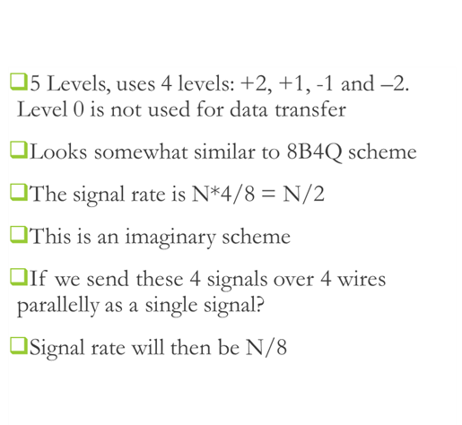
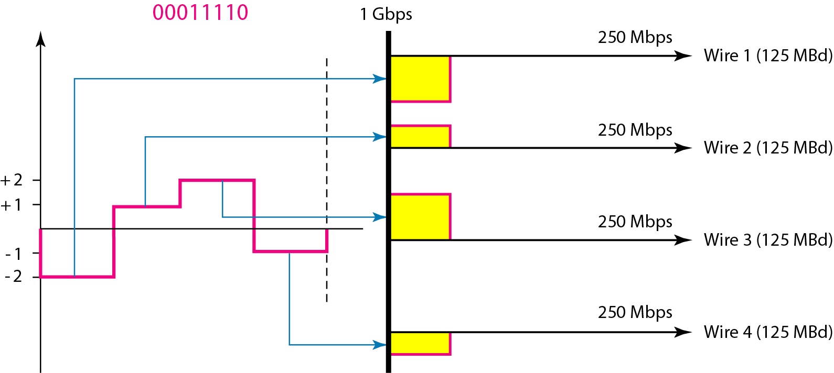
Line Coding: 4D-PAM5
8B4Q
Multilevel: 4D-PAM5 Scheme – used in Gigabit LANs

Slide 41
Multilevel: 4D-PAM5 Scheme – used in Gigabit LANs

Slide 42
In some cases, we split the signal transmission up and distribute it over several links.
The separate segments are transmitted simultaneously. This reduces the signaling rate per link -> lower bandwidth.
This requires all bits for a code to be stored.
xD: means that we use ‘x’ links
YYYz: We use ‘z’ levels of modulation where YYY represents the type of modulation (e.g. pulse amplitude modulation - PAM).
Codes are represented as: xD-YYYz

Slide 43
Line Coding: Multitransition: MLT-3
Uses 3 levels: +V, 0 and –V
Three transition rules
  If the next bit is 0, there is no transition
  If the next bit is 1 and the current level is not 0, the next level is 0
  If the next bit is 1 and the current level is 0, the next level is the opposite of the last nonzero level

Slide 44
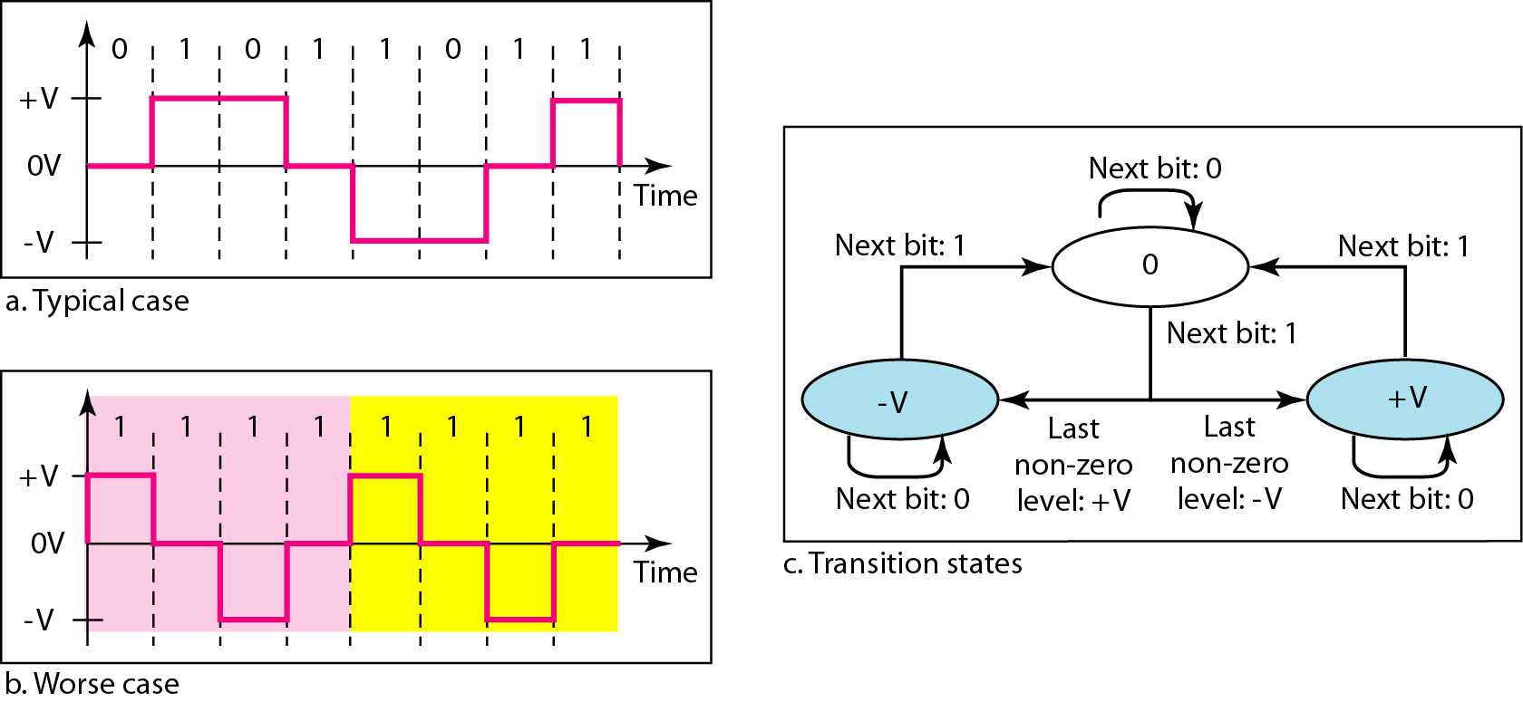
Multitransition: MLT-3 Scheme

Slide 45
Signal rate is same as NRZ-I
Because of the resulting bit pattern, we have a periodic signal for worst case bit pattern: 1111
This can be approximated as an analog signal a frequency 1/4 the bit rate!

Slide 46
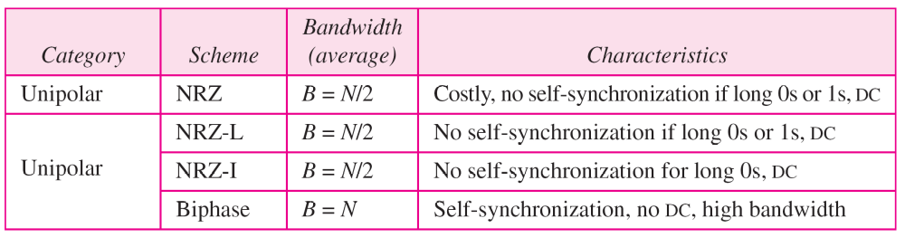
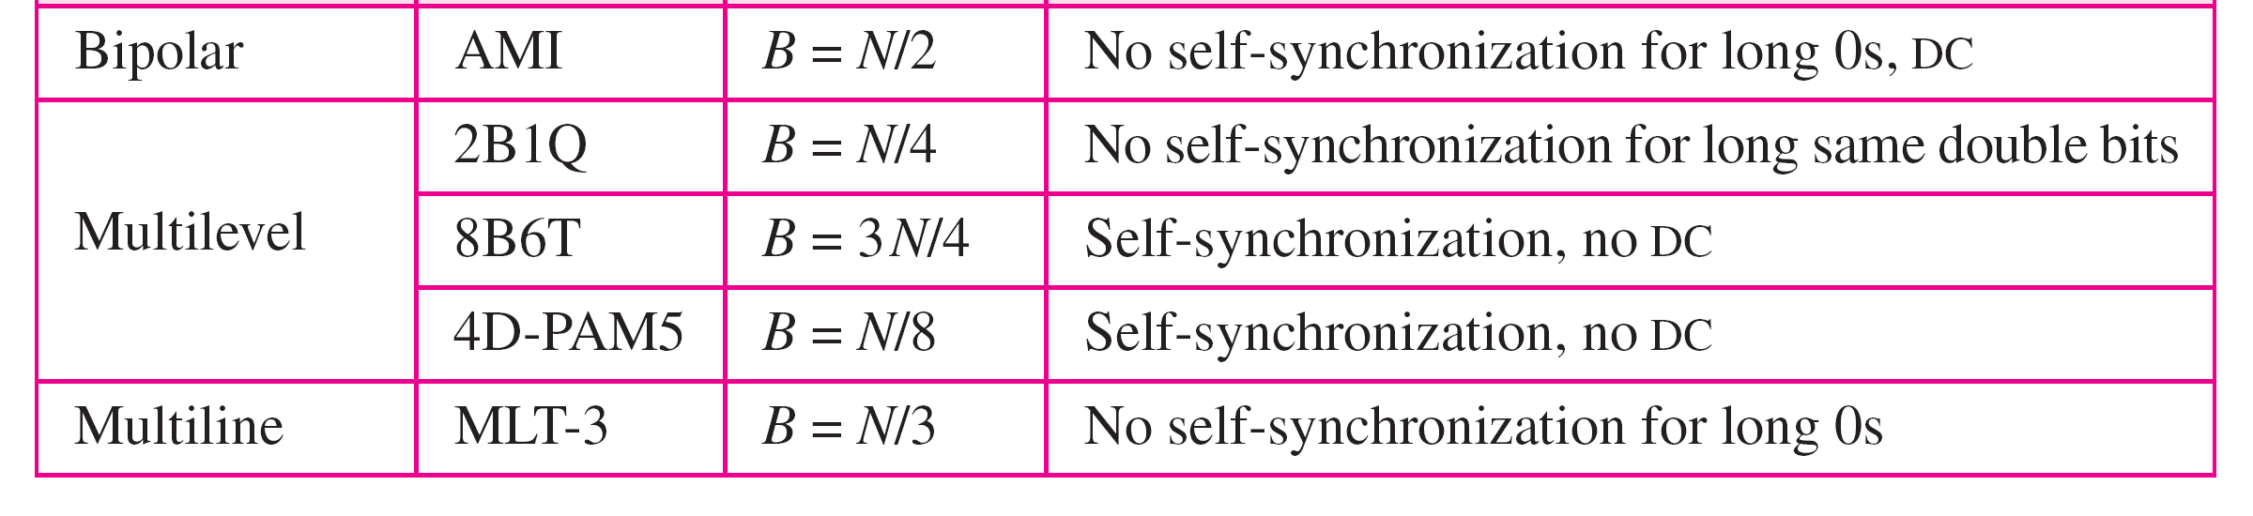

Slide 47
Block Coding
Block codes provide redundancy and improves performance of line coding
  Redundancy is needed for synchronization and providing some kind of inherent error detecting
Block coding changes a block of m bits into a block of n bits
  n > m
Referred to as mB/nB encoding technique involves 3 steps
  Division – sequence of bits is divided into m-bits
  Substitution – substitute an m-bit group with an n-bit group
  Combination – n-bit group is combined to form a stream
The new stream has more bits than the original bits
Block coding is normally referred to as mB/nB coding;
It replaces each m-bit group with an n-bit group

Slide 48
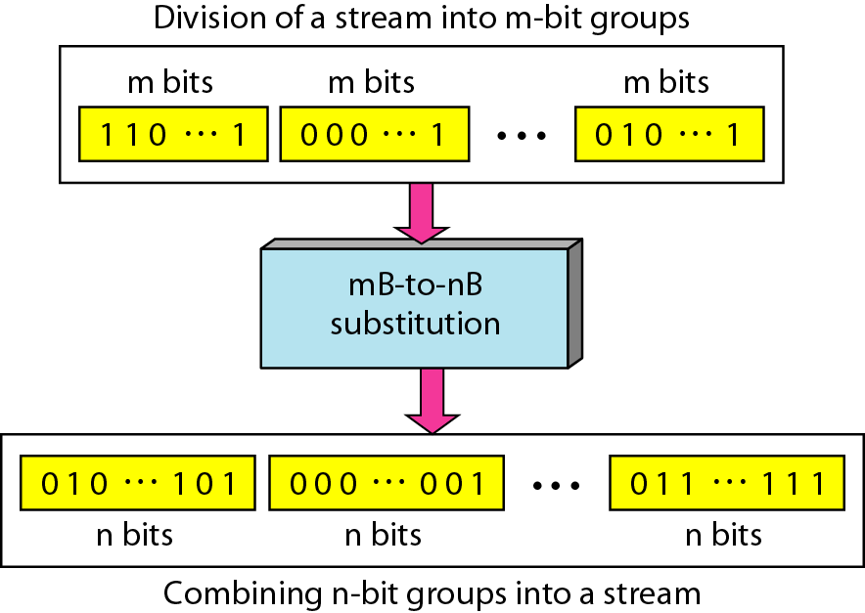
Block Coding Concept
The resulting bit stream prevents certain bit combinations that when used with line encoding would result in DC components or poor synchronization quality

Slide 49
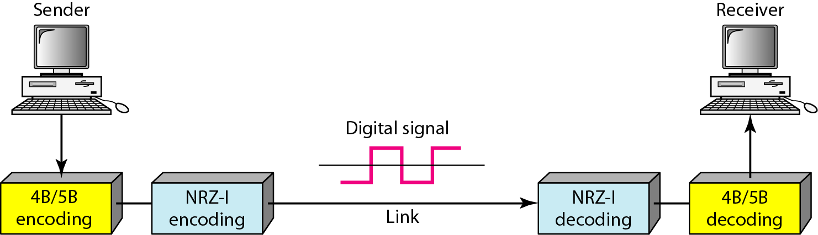
Using Block Coding 4B/5B with NRZ-I line coding scheme
Issues with NRZ-I (Revisited):
Synchronization problem – a long sequence of 0s can make receiver clock lose synchronization
Resolved with 4B/5B encoding:
Block coded stream does not have more than 3 consecutive zeros

Slide 50
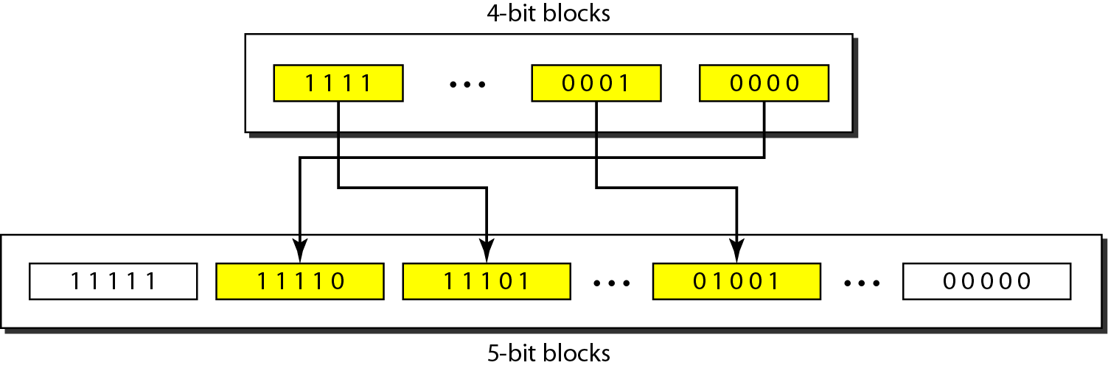
Substitution in 4B/5B block coding
Redundancy:
A 4 bit data word can have 2⁴ = 16 combinations
A 5 bit word can have 2⁵ = 32 combinations
No. of extra words = 32 – 16 = 16
Some of these extra words are used for control/signaling purposes

Slide 51
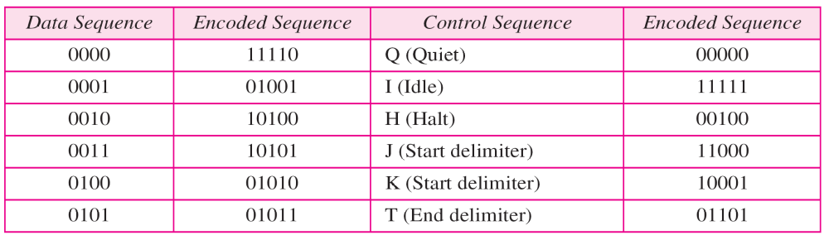
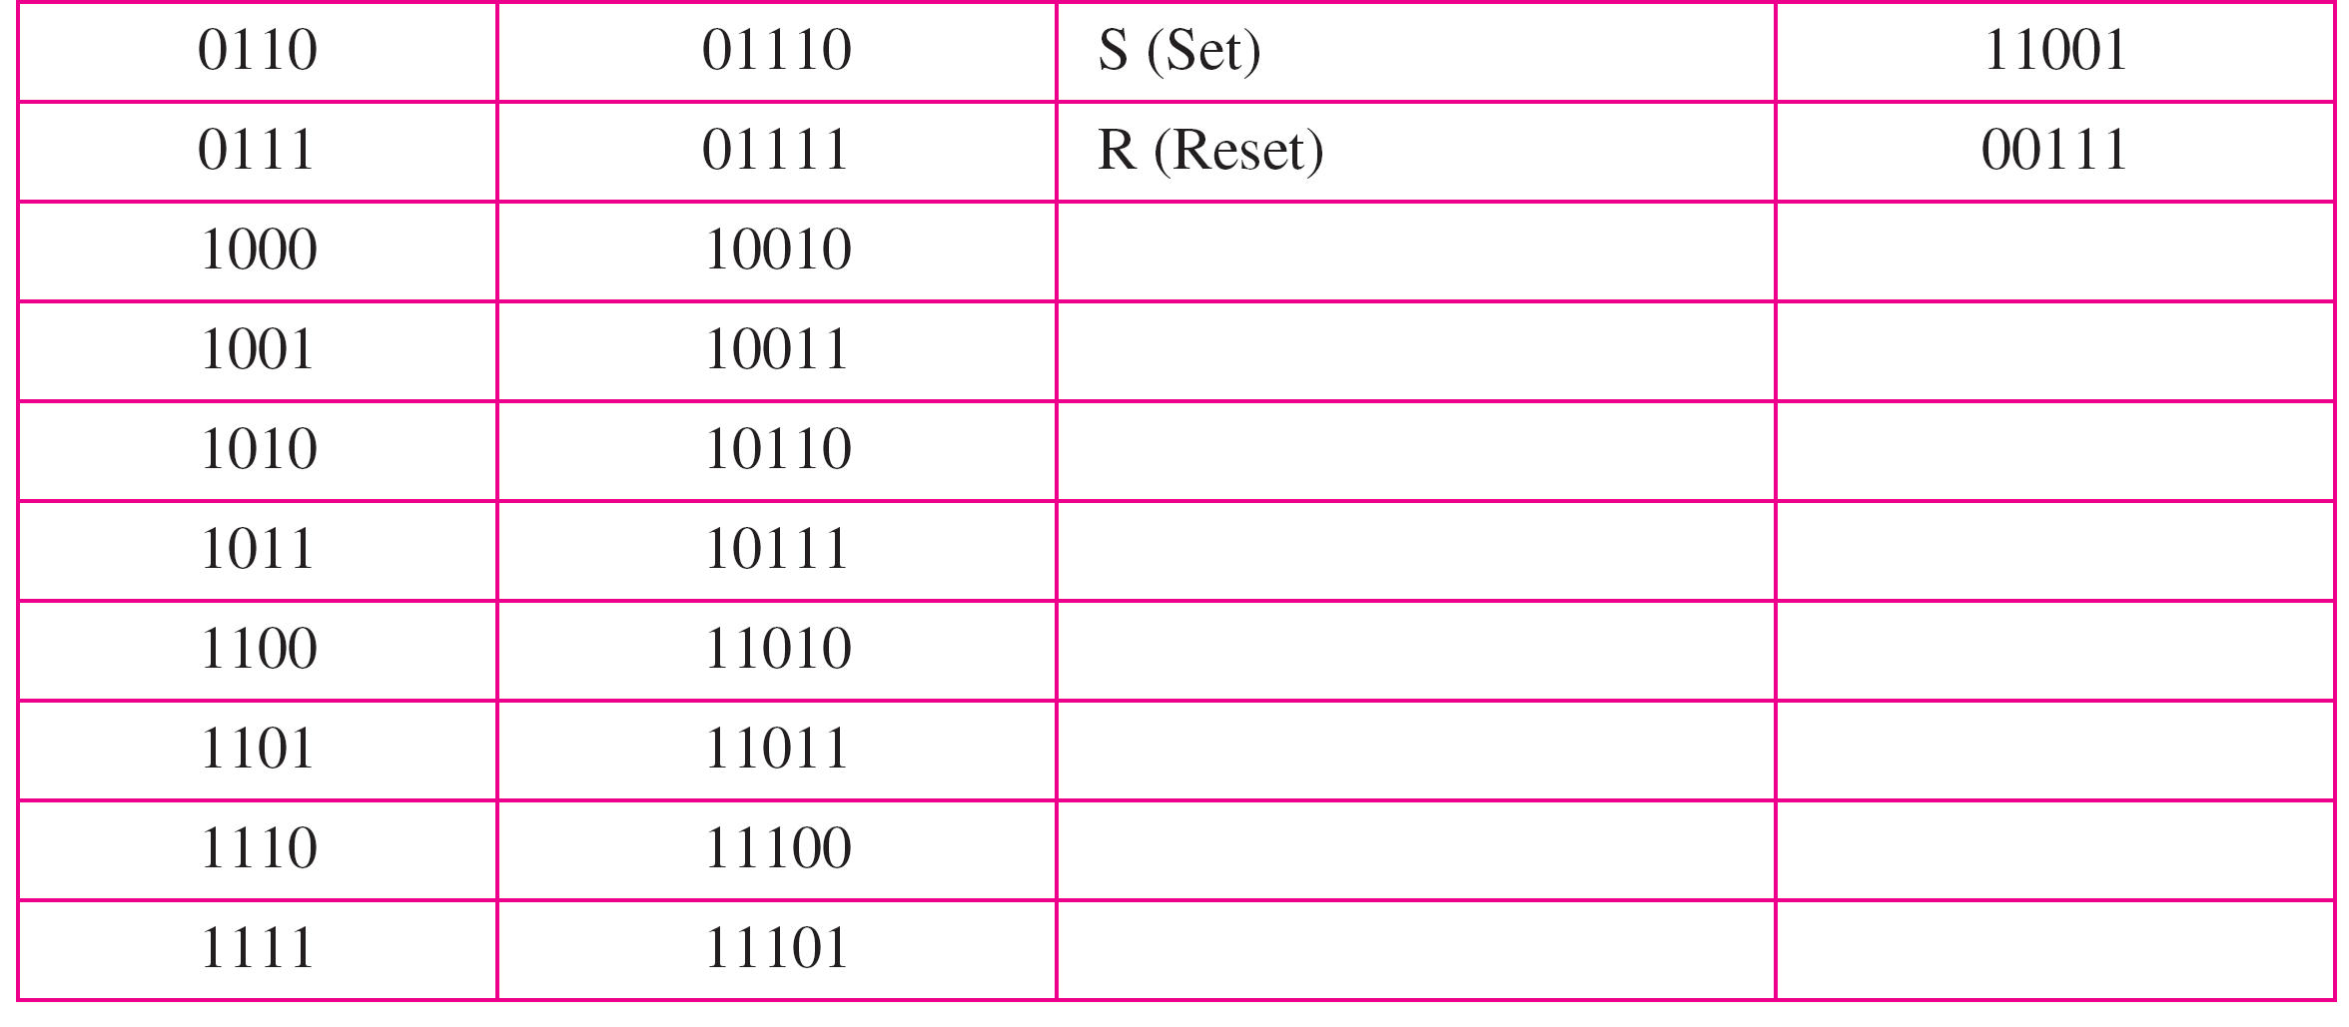
4B/5B Mapping codes

Slide 52
We need to send data at a 1-Mbps rate. What is the minimum required bandwidth, using a combination of 4B/5B and NRZ-I or Manchester coding?
Solution
First 4B/5B block coding increases the bit rate to 1.25 Mbps.
The minimum bandwidth using NRZ-I is N/2 or 625 kHz.
The Manchester scheme needs a minimum bandwidth of 1.25 MHz.
The first choice needs a lower bandwidth, but has a DC component problem;
The second choice needs a higher bandwidth but does not have a DC component problem.

Slide 53
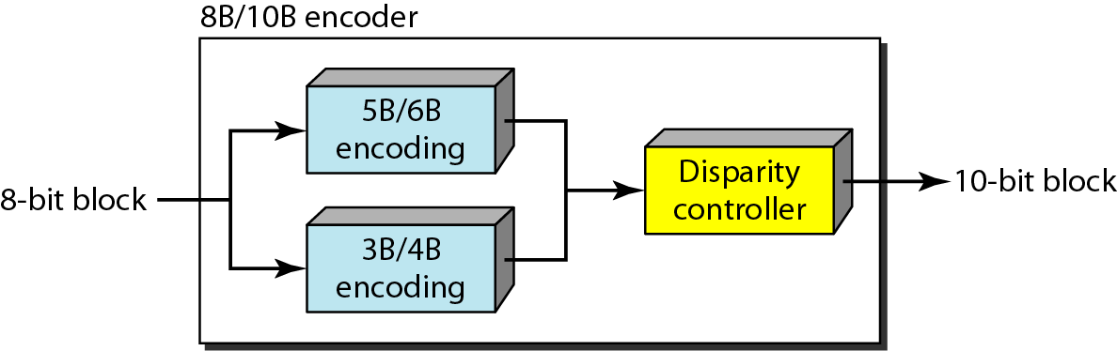
8B/10B Block Encoding
More the bits – better the error correction:
No. of redundant bits = 2¹⁰ – 2⁸ = 768
The 8B10B block code adds more redundant bits
Thereby choose code words that would prevent a long run of a voltage level that would cause DC components

Slide 54
Scrambling
Biphase schemes are not suitable in long-distance communications due to wide bandwidth requirement
Combination of block codes and NRZ line coding are not suitable for long-distance communications due to the of DC component
Bipolar AMI are preferred for long distances
  Scrambling offers a solution that does not increase the number of bits and does provide synchronization
  Modifies part of the AMI rule to include scrambling
  Scrambling, as opposed to block coding, is done at the same time as line coding
  System inserts required pulses based on the defined scrambling rules
  Two common scrambling techniques
    B8ZS (Bipolar with 8 Zero Substitution)
    HDB3 (High-Density Bipolar 3-zero)

Slide 55
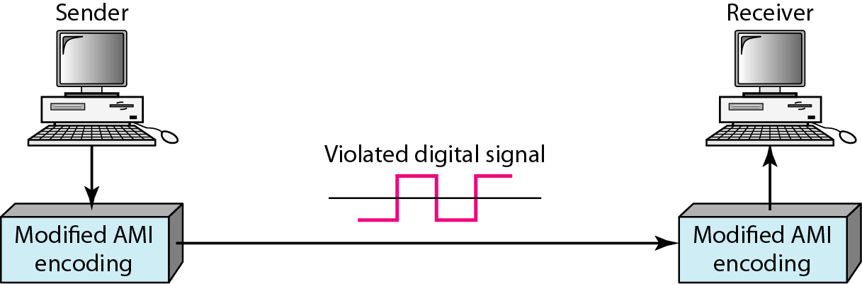
AMI used with Scrambling

Slide 56
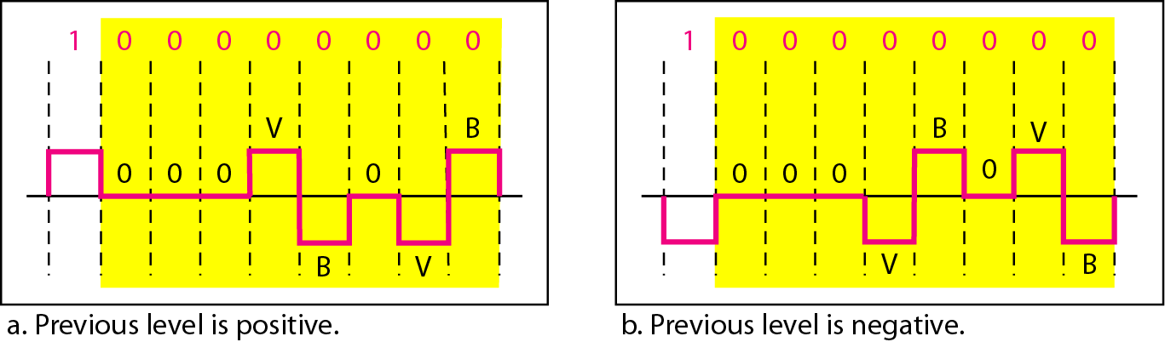
Two cases of B8ZS Scrambling
The V means the same polarity as the polarity of the previous nonzero pulse;
B means the polarity opposite to the polarity of the previous nonzero pulse.
B8ZS substitutes eight consecutive zeros with 000VB0VB.
The V stands for violation, it violates the AMI line encoding rule
B stands for bipolar, a nonzero level voltage following the AMI rule

Slide 57
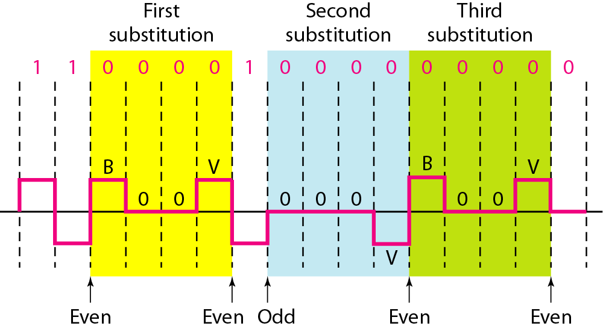
HDB3 substitutes four consecutive zeros with 000V or B00V depending on the number of nonzero pulses after the last substitution.
If # of non-zero pulses are even, the substitution is B00V to maintain total # of non-zero pulse even.
If # of non-zero pulses are odd, the substitution is 000V to make total # of non-zero pulses even.

Slide 58
Analog-to-Digital Conversion
Pulse Code Modulation
Delta Modulation

Slide 59
Pulse Coded Modulation (PCM)
PCM is the most common technique to change an analog signal into digital (digitization)
PCM encoder has 3 processes
  Sampling – analog signal is sampled
  Quantization – analog signal is quantized
  Encoding – quantized values are encoded as stream of bits

Slide 60
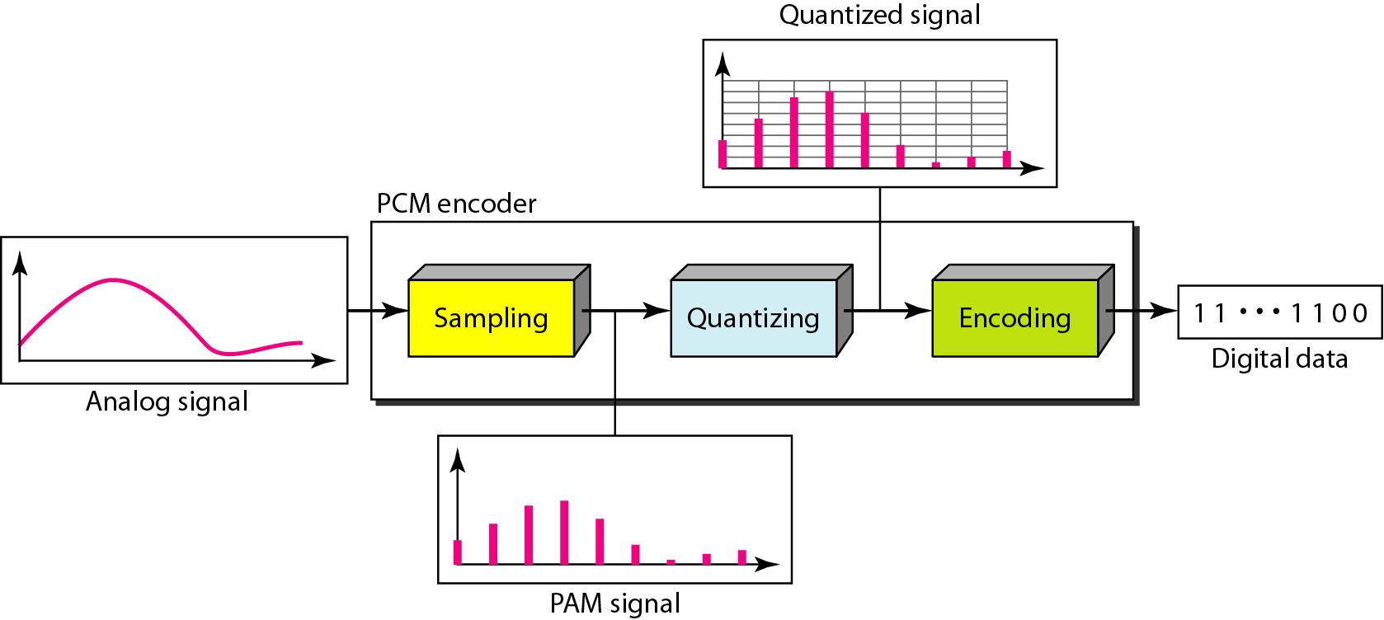
Components of the PCM Encoder

Slide 61
PCM (Sampling)
Analog signal is sampled every T_{S} secs
  T_{s} is the sample interval or period
    Inverse is called Sampling Rate or Sampling frequency (f_{s})
Three sampling methods:
  Ideal - an impulse at each sampling instant
    Cannot be easily implemented
  Natural - a pulse of short width with varying amplitude
    High-speed switch is turned on for a small period
  Flat-top - sample and hold, like natural but with single amplitude value
    Most common method created using a circuit
The process is referred to as pulse amplitude modulation PAM and the outcome is a signal with analog (non integer) values

Slide 62
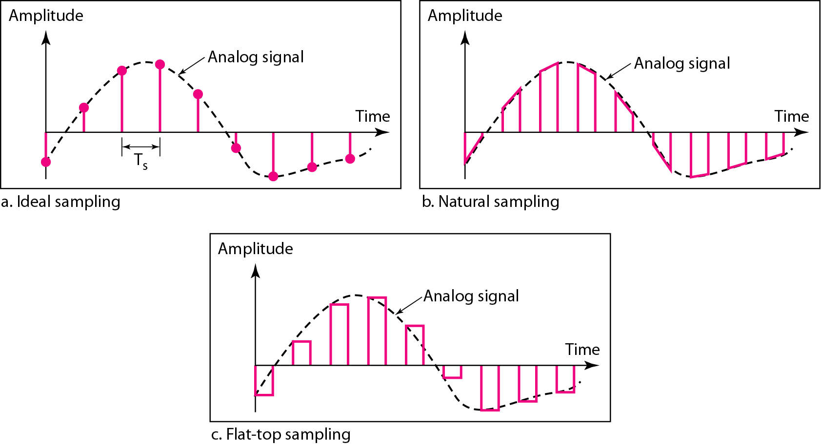
3 different Sampling Methods for PCM

Slide 63
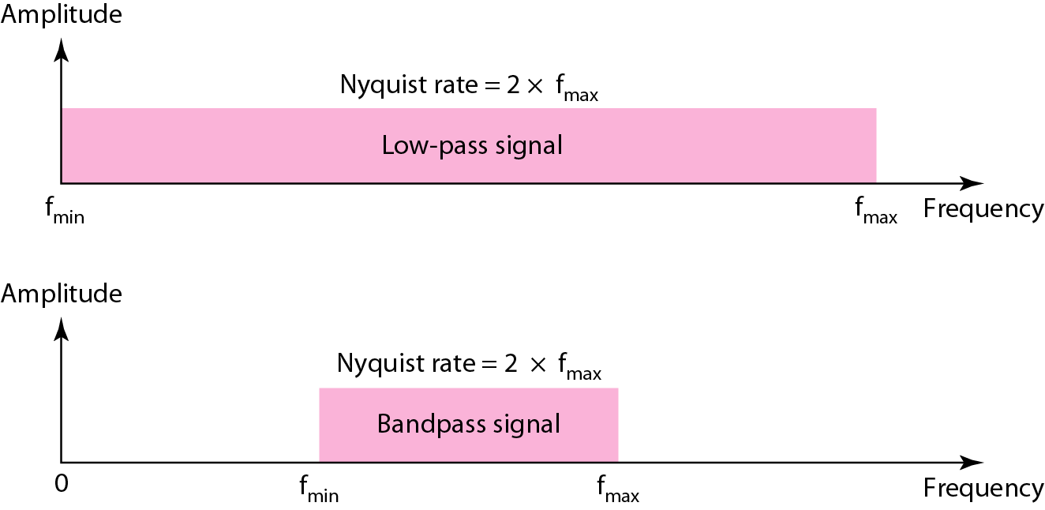
PCM: Sampling Rate
Nyquist Theorem
  To reproduce the original analog signal, one necessary condition is that the sampling rate be at least twice the highest frequency in the original signal
  Sampling can be done only if the signal is band-limited i.e. infinite frequency signal can not be sampled
  Sampling rate must be 2 times the highest frequency; not the bandwidth
Nyquist sampling rate for low-pass and bandpass signals

Slide 64
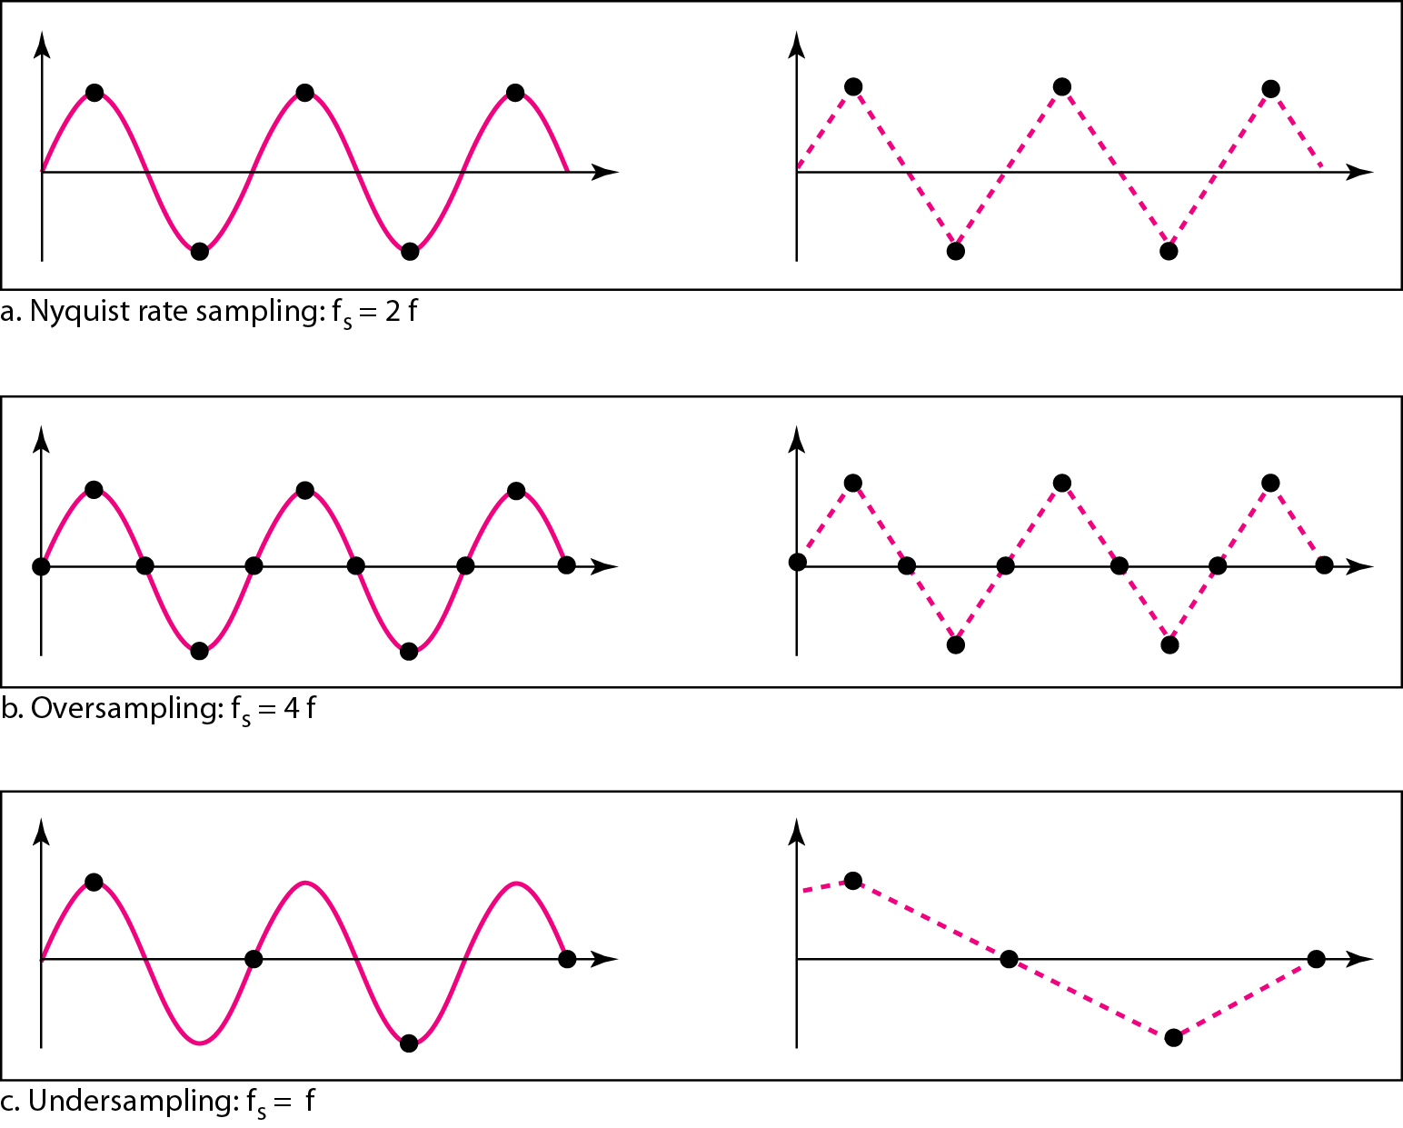
For an intuitive example of the Nyquist theorem, let us sample a simple sine wave at three sampling rates: f_{s} = 4f (2 times the Nyquist rate), f_{s} = 2f (Nyquist rate), and f_{s} = f (one-half the Nyquist rate).
Sampling at the Nyquist rate can create a good approximation of the original sine wave
Fig. b and Fig. c does not produce the original signal
Recovery of a sampled sine wave for different sampling rates

Slide 65
Consider the revolution of a hand of a clock.
The second hand of a clock has a period of 60 s.
According to the Nyquist theorem, we need to sample the hand every 30 s (T_{s} = T/2 or f_{s} = 2f ).
  In part a, the sample points, in order, are 12, 6, 12, 6, 12, and 6.
  The receiver of the samples cannot tell if the clock is moving forward or backward
In part b, we sample at double the Nyquist rate (every 15 s). The sample points are 12, 3, 6, 9, and 12.
  The clock is moving forward
In part c, we sample below the Nyquist rate (T_{s} = 3T/4 or f_{s} = 4f/3 ).
  The sample points are 12, 9, 6, 3, and 12.
  Although the clock is moving forward, the receiver thinks that the clock is moving backward.

Slide 66
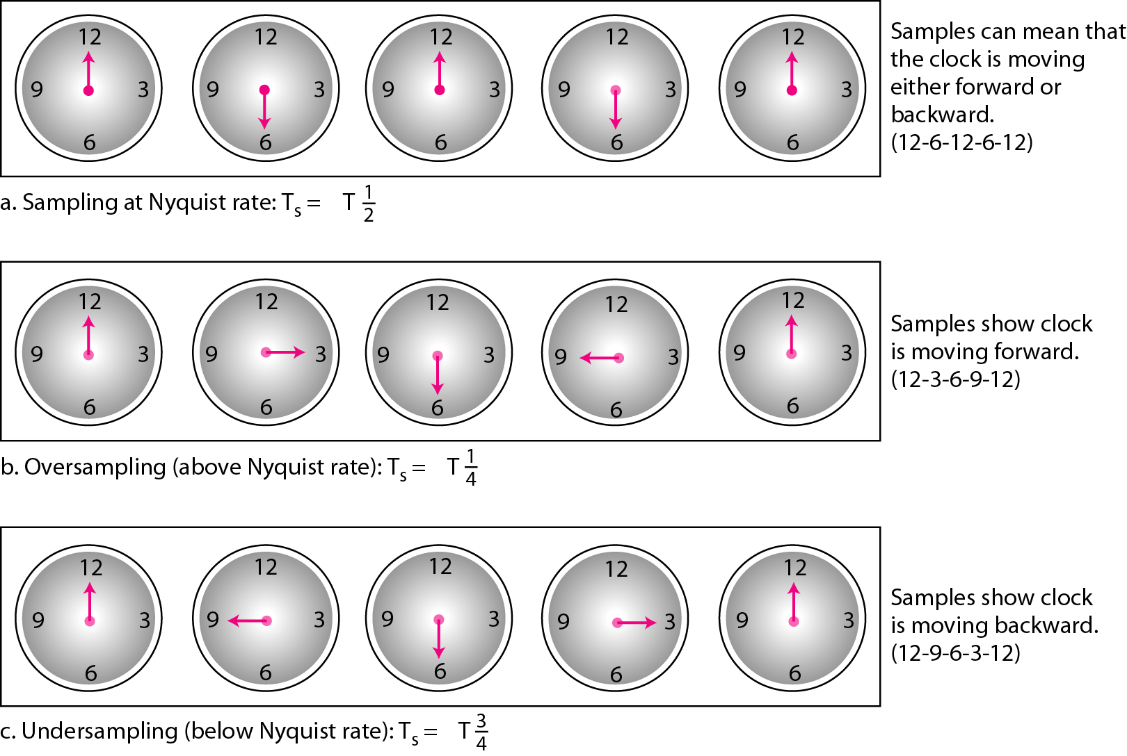
Sampling of the clock with only one hand

Slide 67

An example related to seemingly backward rotation of the wheels of a forward-moving car in a movie. This can be explained by under-sampling. A movie is filmed at 24 frames per second. If a wheel is rotating more than 12 times per second, the under-sampling creates the impression of a backward rotation
Video Demo: C14 5 Wagon wheel effect

Slide 68
Telephone companies digitize voice by assuming a maximum frequency of 4000 Hz. The sampling rate therefore is 8000 samples per second
A complex low-pass signal has a bandwidth of 200 kHz. What is the minimum sampling rate for this signal?
Solution
The bandwidth of a low-pass signal is between 0 and f, where f is the maximum frequency in the signal. Therefore, we can sample this signal at 2 times the highest frequency (200 kHz). The sampling rate is therefore 400,000 samples per second
A complex bandpass signal has a bandwidth of 200 kHz. What is the minimum sampling rate for this signal?
Solution
We cannot find the minimum sampling rate in this case because we do not know where the bandwidth starts or ends. We do not know the maximum frequency in the signal.

Slide 69
PCM: Quantization
Sampling results in a series of pulses of varying amplitude values ranging between two limits: a_{min} and a_{max}
The amplitude values are infinite between the two limits
Need to map the infinite amplitude values onto a finite set of known values
  This is achieved by dividing the distance between min and max into L zones, each of height Δ.
= (max - min)/L
The midpoint of each zone is assigned a value from 0 to L-1 (resulting in L values)
Each sample falling in a zone is then approximated to the value of the midpoint

Slide 70
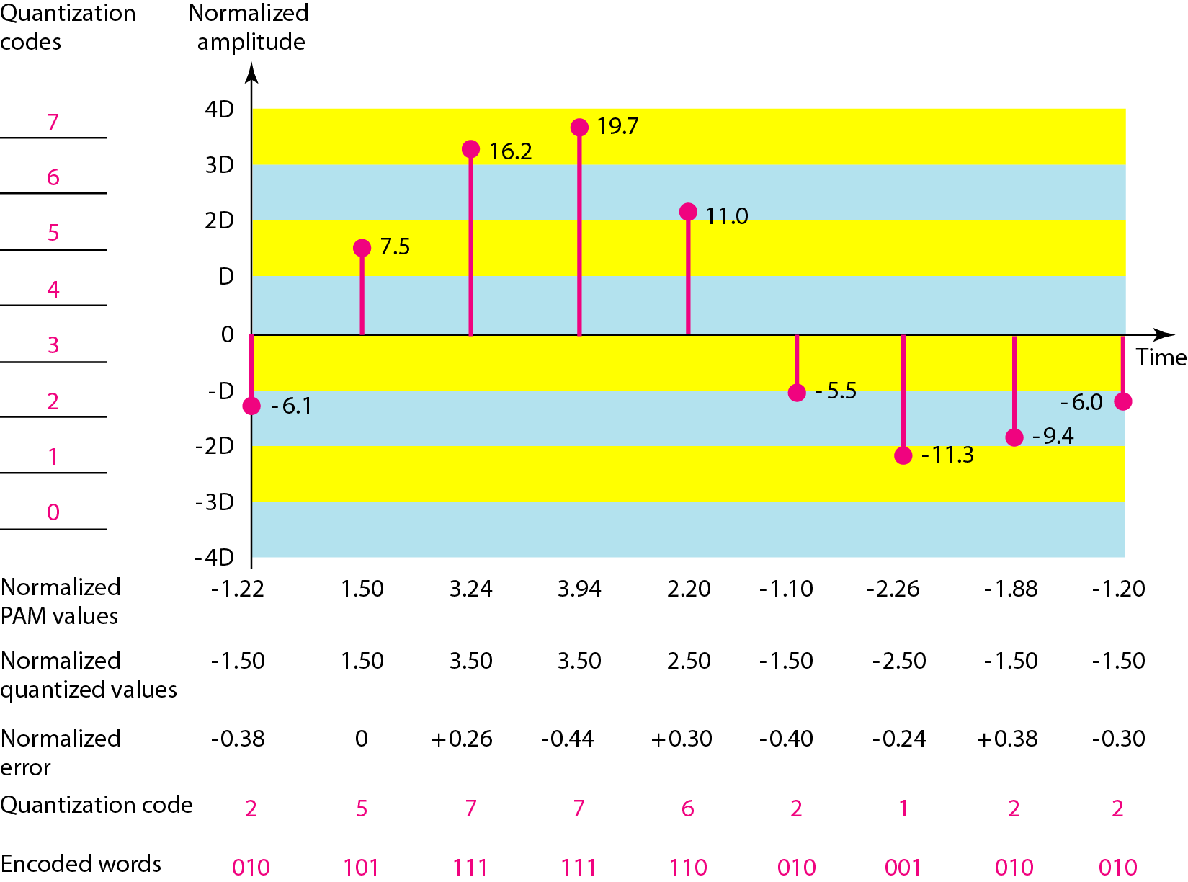
Quantization and Encoding of a sampled signal

Slide 71
Maximum Voltage Vmax = 20 V
Minimum Voltage Vmin = - 20 V
Figure shows the actual amplitudes (ideal sampling)
Normalized PAM values = actual amplitudes / ∆
Normalized Quantized values = (mid point amplitude in each zone) / ∆
Normalized error = Normalized Quantized values – Normalized PAM values
Quantization code – is based on the quantization levels at the left of the graph
Encoded works – final products of the conversion

Slide 72
Quantization Zones
Assume a voltage signal with amplitudes
V_{min}= - 20V and V_{max} = + 20V.
We want to use L = 8 quantization levels
Zone width Δ = (20 – (-20))/8 = 5
The 8 zones are: -20 to -15, -15 to -10, -10 to -5, -5 to 0, 0 to +5, +5 to +10, +10 to +15, +15 to +20
The midpoints are: -17.5, -12.5, -7.5, -2.5, 2.5, 7.5, 12.5, 17.5
Assigning Codes to Zones
Each zone is then assigned a binary code.
The number of bits required to encode the zones, or the number of bits per sample is as follows:
n_{b} = log ₂ L
Given our example, n_{b} = 3
The 8 zone (or level) codes are therefore: 000, 001, 010, 011, 100, 101, 110, and 111
Assigning codes to zones:
  000 will refer to zone -20 to -15
  001 to zone -15 to -10, etc.

Slide 73
Quantization Error
When a signal is quantized, we introduce an error - the coded signal is an approximation of the actual amplitude value.
The difference between actual and coded value (midpoint) is referred to as the quantization error.
The more zones, the smaller Δ which results in smaller errors.
BUT, the more zones the more bits required to encode the samples -> higher bit rate
Changes the signal-to-quantization-noise ratio of the signal
  Reduces upper limit capacity (as per Shannon)
Signals with lower amplitude values will suffer more from quantization error as the error range: Δ/2, is fixed for all signal levels
Nonlinear quantization is used to alleviate this problem. The goal is to keep SNR fixed for all sample values
SQNR_{db} = 6.02 n_{b} + 1.76 dB
Where, n_{b} – number of bits per sample
n_{b} = log₂ L

Slide 74
What is SNR_{db} in the previous example?
SNR_{dB} = 6.02(3) + 1.76 = 19.82 dB
A telephone subscriber line must have an SNR_{db} above 40. What is the minimum number of bits per sample?
SNR_{db} = 6.02 n_{b} + 1.76 = 40 ➔ n = 6.35

Slide 75
Uniform Versus Nonuniform Quantization
  For many applications, the distribution of instantaneous amplitudes in the analog signal is not uniform
    Amplitude changes more frequently in lower amplitudes than in higher ones
    In speech and audio signals, lower amplitudes are more frequent than higher amplitudes.
  Hence, use non-uniform zones
    Height of ∆ is not fixed
    ∆ is smaller at lower amplitudes and greater at higher amplitudes
  Achieved by using a process called companding (at sender) and expanding (at receiver)
    Companding reduces the instantaneous voltage amplitude for large values
      Gives greater weightage to strong signals
      Gives less weightage to weak signals
    Expanding is the opposite of companding
  Effectively reduces SNR_{db} of quantization

Slide 76
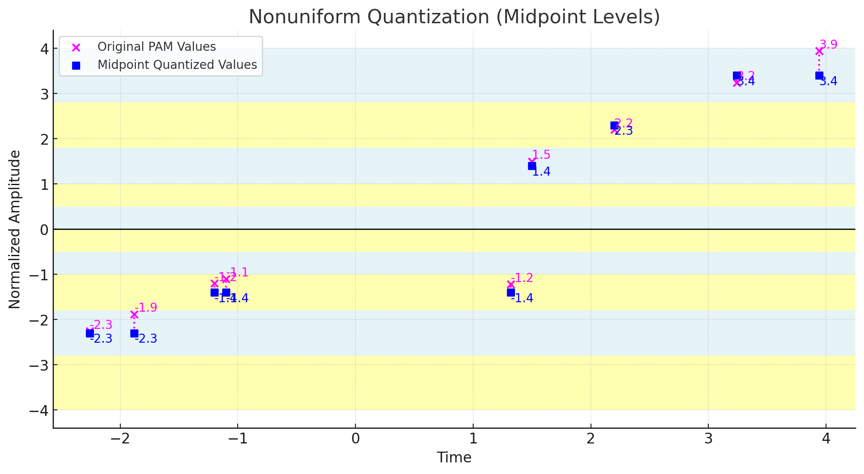
Uniform Versus Nonuniform Quantization

Slide 77
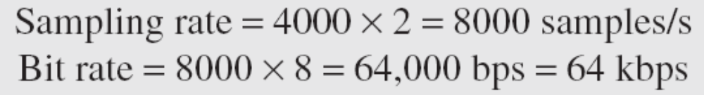
Encoding
  After each sample is quantized, number of bits per sample is decided
  Each sample is changed to an n_{b} – bit code word
  Number of bits for each sample (n_{b}) is determined by the number of quantization levels (L)
    n_{b} = log ₂ L
  Bit rate = sampling rate X number of bits per sample
  Bit rate = f_{s} x n_{b}
We want to digitize the human voice. What is the bit rate, assuming 8 bits per sample?
Solution
The human voice normally contains frequencies from 0 to 4000 Hz. So the sampling rate and bit rate are calculated as follows:

Slide 78
Original Signal recovery
  Requires PCM decoder
  Decoder uses circuitry to convert the code words into a pulse that holds the amplitude until the next pulse
  Stair-case pulse so created is sent through low pass filter to generate smooth analog signal
    Filter has same cut-off frequency as the original signal at the sender
  If the signal is sampled at the Nyquist sampling rate (or greater), if enough quantization levels are available, original signal will be recreated
  Maximum and minimum values of original signal can be achieved by amplification

Slide 79
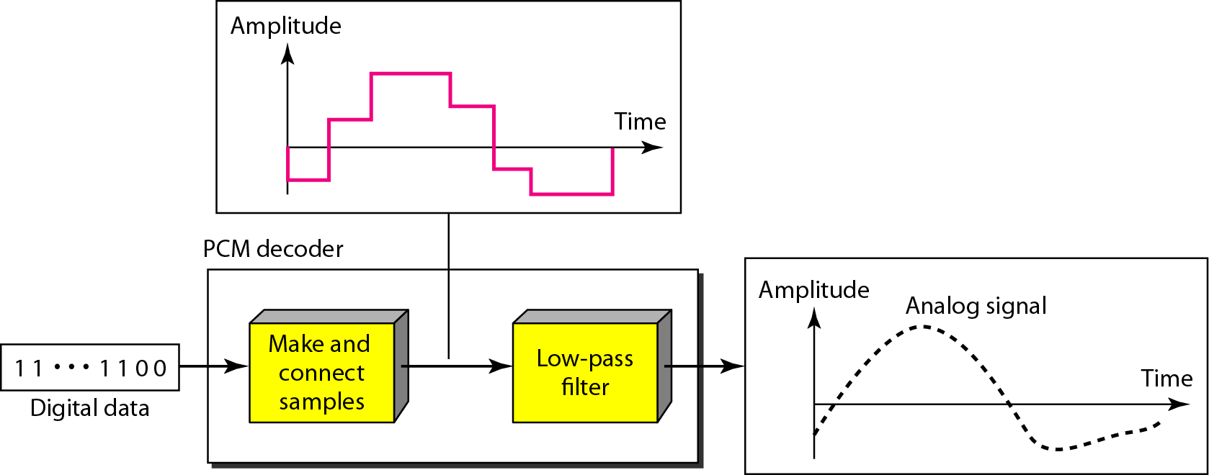
Components of the PCM decoder

Slide 80
PCM Bandwidth
  Minimum bandwidth of a line-encoded signal
  B_{min} = c * N * (1/r)
  B_{min} = c * n_{b} * f_{s} * (1/r)
  B_{min} = c * n_{b} * 2 * B_{analog} * (1/r)
  When 1/r = 1 for NRZ or bipolar and c = ½ (the average situation)
    B_{min} = n_{b} * B_{analog}
    Minimum bandwidth of the digital signal is n_{b} times greater than the bandwidth of the analog signal
      Price we pay for digitization

Slide 81
We have a low-pass analog signal of 4 kHz. If we send the analog signal, we need a channel with a minimum bandwidth of 4 kHz. If we digitize the signal and send 8 bits per sample, we need a channel with a minimum bandwidth of 8 × 4 kHz = 32 kHz.

Slide 82
Maximum Data Rate of a Channel
  Data rate of the channel
  N_{max} = 2 * B * log ₂ L
Proof:
  Assume that the available channel is low-pass with bandwidth B
  Assume that the digital signal we want to send has L levels, each level is a signal element
  r = 1/log ₂ L
  First, pass the digital signal through a low – pass filter to cut off the frequencies above B Hz
  Treat the resulting signal as an analog signal and sample it at 2 * B samples per second and quantize it using L levels
    Additional levels are useless as the original signal had L levels
  Resulting bit rate is
  N = f_{s} * n_{b} = 2 * B * log ₂ L
  Hence, the maximum bitrate is
  N_{max} = 2 * B * log₂L bps
  Minimum Required Bandwidth
  B_{min} = N /(2 * log₂L) Hz

Slide 83
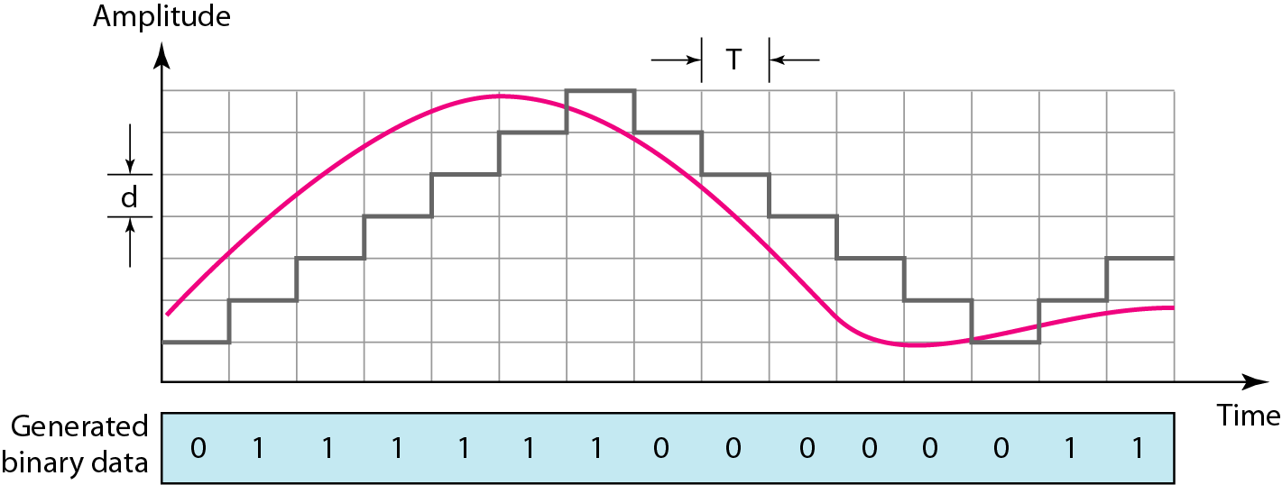
Delta Modulation
PCM is a very complex technique
PCM finds value of signal amplitude for each sample | DM finds change from previous sample
Process of delta modulation

Slide 84
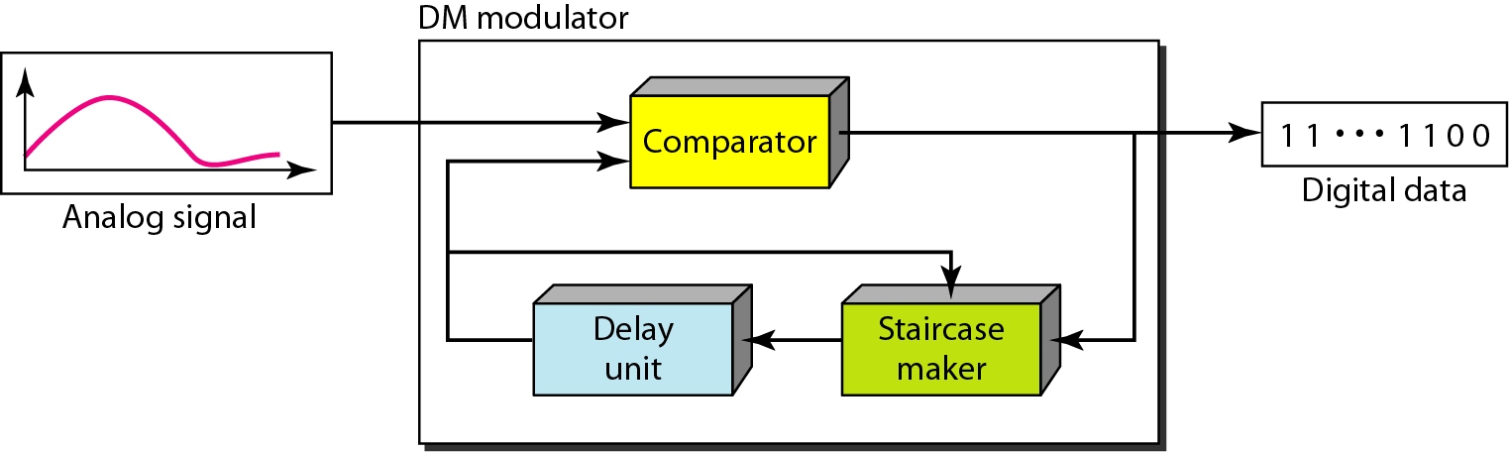
Components of Delta Modulation
Modulator used at sender site
  Create stream of bits from the analog signal
  Process records small positive or negative changes called delta ()
    Records 1 or 0 respectively
  Process needs a base against which the analog signal is compared
  Builds a second signal that resembles a staircase
Hence, finding the change is reduced to comparing the input signal with the gradually made staircase signal
Delay unit holds the staircase function for a period between two comparisons

Slide 85
Modulator used at sender site
If the difference between the current and previous sample is greater than or equal to Δ, the system registers an increase (1) or decrease (0).
If the difference is smaller than Δ, the output remains unchanged.
Key Implications
Smaller Δ
  Captures small variations in the signal
  Reduces granular noise but increases the chance of slope overload for fast-changing signals
Larger Δ
  Better for tracking rapid changes in the signal.
  May ignore small variations, leading to granular noise
Example, Suppose Δ = 0.5V
If the previous sample = 2.0V and the current sample = 2.3V, Since (2.3V - 2.0V = 0.3V < 0.5V), no change is recorded.
If the current sample = 2.6V, Since (2.6V - 2.0V = 0.6V > 0.5V), an increase is recorded (output = ‘1’).

Slide 86
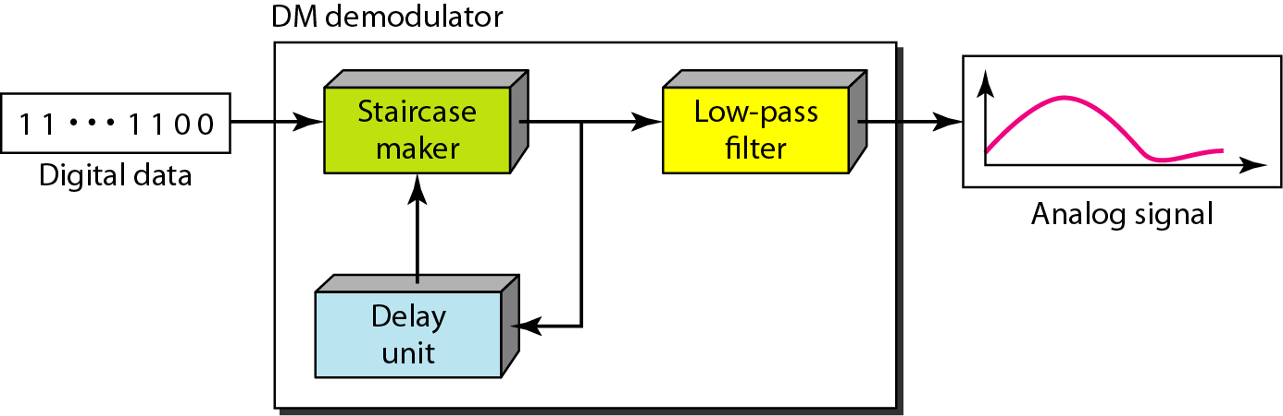
Components of Delta demodulation
Demodulator used at receiver site
  Takes digital data and, using staircase maker and delay unit, creates analog signal
  The analog signal needs to pass through a low pass filter for smoothing

Slide 87
Adaptive DM
  If  value is not fixed, better performance can be achieved
    Value of  changes according to the amplitude of the analog signal
Quantization error is introduced
  But, much less than that for PCM

Slide 88
Transmission modes
Parallel Transmission
Serial Transmission

Slide 89
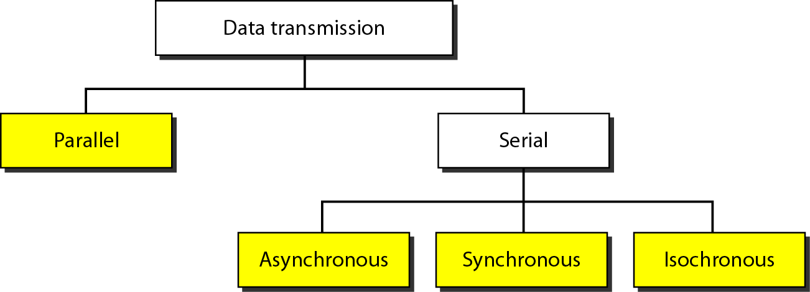
Data Transmission Modes

Slide 90
Parallel Transmission
Parallel Transmission – multiple bits are sent with each clock tick
  Binary data is organized into groups of n bits each
  By grouping, we send data n bits at a time instead of 1
Use n wires to send n bits at one time
Advantage:
  Speed
  Can increase transfer speed by a factor of n over serial transmission
Disadvantage
  Cost
  Hence, limited to short distances

Slide 91
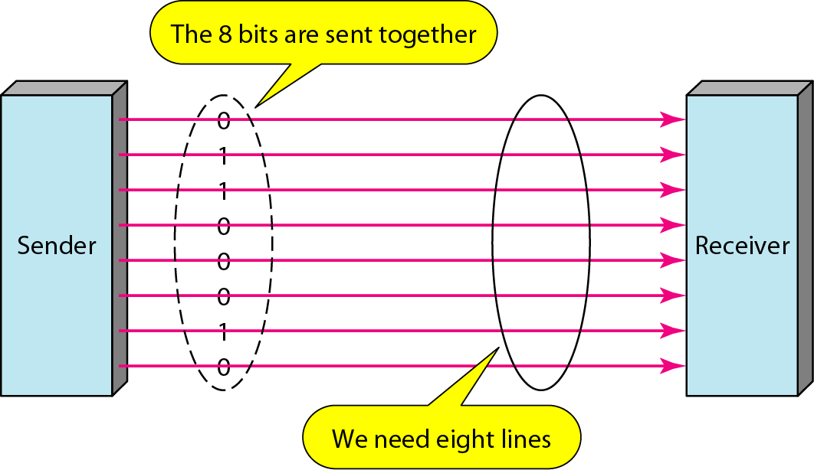
Parallel Transmission

Slide 92
Serial Transmission
One bit follows another
  Hence, only one communication channel is needed rather than n to transmit data between two communicating devices
Advantage:
  Reduces cost of transmission over parallel by roughly a factor of n
Since communication within devices is parallel
  Conversion devices are required at interface between sender and the line (parallel – to – serial) and between the line and the receiver (serial – to – parallel)
Serial transmission occurs in
  Asynchronous
  Synchronous
  Isosynchronous

Slide 93
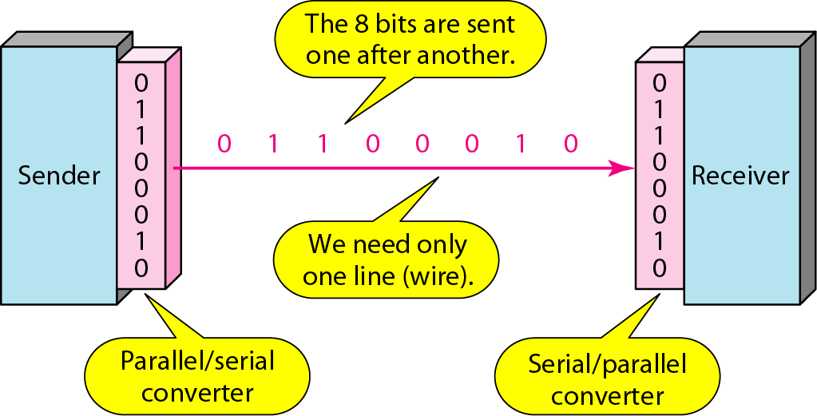
Serial Transmission

Slide 94
Serial transmission: Asynchronous
Transmission
Timing of the signal is unimportant
Information is received and translated by agreed upon patterns
  Patterns are based on grouping bit stream into bytes
Each group (8 bits) is sent along the link as a unit
Sending system handles each group independently
  Relaying to link without regard to a timer
Without synchronization, receiver cannot use timing to predict when the next group will arrive
To alert receiver, an extra bit (0) is added to beginning of each byte
  Also called start bit
To let receiver know that the byte is finished, 1 or more additional bits are appended to the end of the byte
  Also called stop bits

Slide 95
To transmit 1 byte, at least 10 bits are transmitted
  2 additional bits for control
Transmission of each byte may be followed by a gap of varying duration
This gap can be represented either by an idle channel or by a stream of additional stop bits
In asynchronous transmission, we send 1 start bit (0) at the beginning and 1 or more stop bits (1s) at the end of each byte. There may be a gap between each byte.
Asynchronous here means “asynchronous at the byte level,”
but the bits are still synchronized;
their durations are the same.

Slide 96
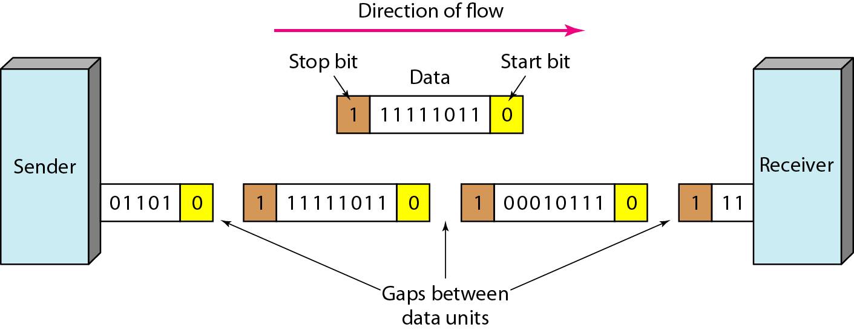
Asynchronous Transmission
Example:
Connection of a keyboard to a computer
  User types only one character at a time
  Extremely slowly in terms of data processing
  Leaves unpredictable gaps of time between characters

Slide 97
Serial Transmission: Synchronous Transmission
Bit stream is combined into longer frames, which may contain multiple bytes
  Each byte is introduced onto the transmission link without a gap between it and the next one
Left to the Receiver to separate bit stream into bytes for decoding purposes
  Data are transmitted as an unbroken string of 1s and 0s and receiver separates that string into bytes or characters
In synchronous transmission, we need bits one after another without start or stop bits or gaps. It is the responsibility of the receiver to group the bits.

Slide 98
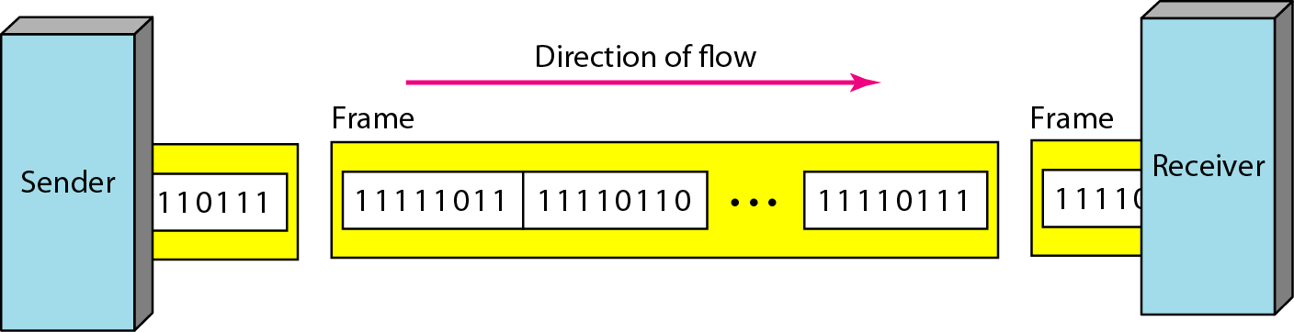
Synchronous transmission
The divisions shown do not exist
Sender puts data onto the line as long string
If sender puts data in bursts, the gaps must be filled with special sequence of 0s and 1s i.e. to represent an idle channel
Faster than the asynchronous as no extra bits or gaps
More useful for high-speed applications
Byte synchronization is accomplished in the data-link layer
Uneven gaps may be found between frames
Without gaps, start and stop bits, there is no built-in mechanism to help receiving device adjust its bit synchronization midstream.

Slide 99
Serial Transmission: Isochronous
In real-time audio and video, uneven delays between frames are not acceptable
  Synchronous transmission hence fails
  Guarantees that the data arrive at a fixed rate
  Isochronous transmission is a type of serial data transmission where data is sent at regular, time-sensitive intervals without delays
Example:
TV images are broadcast at the rate of 30 images per second
They must be viewed at the same rate
If each image is sent by using one or more frames, there should be no delays between frames
Hence synchronization of characters is not enough; the entire stream of bits must be synchronized

Slide 100
Thank You!!!

